Slide 1

Week 13 AERO 222 Lab
Problem Assignment: Numerical Integration
Compute the Gauss-Legendre quadrature to approximate the distance covered given the following equation using 3, 4, and 5 points
Report the values in a table for all integrations

Slide 2
Gauss-Legendre quadrature
The idea is: estimate the integral as sum of the function evaluated at some points by some (unknown) weights.
The points and weights are pre-computed (selected optimally)
The interval of integration must be [–1, +1]

Slide 3
Gauss-Legendre quadrature
The interval of integration must be [–1, +1]
For other intervals, [a, b], a change of variables is used to transfer the problem. This is a linear transformation”

Slide 4
Gauss-Legendre quadrature

Slide 5
Gauss-Legendre quadrature

Slide 6
Gauss-Legendre quadrature

Slide 7
Higher-order Gauss-Legendre quadrature

Slide 8
Use 6 equations - constant, linear, quadratic, cubic, 4th order, and 5th order to find those unknowns

Slide 9
Using symmetry …

Slide 10
Gauss-Legendre quadrature

Slide 11
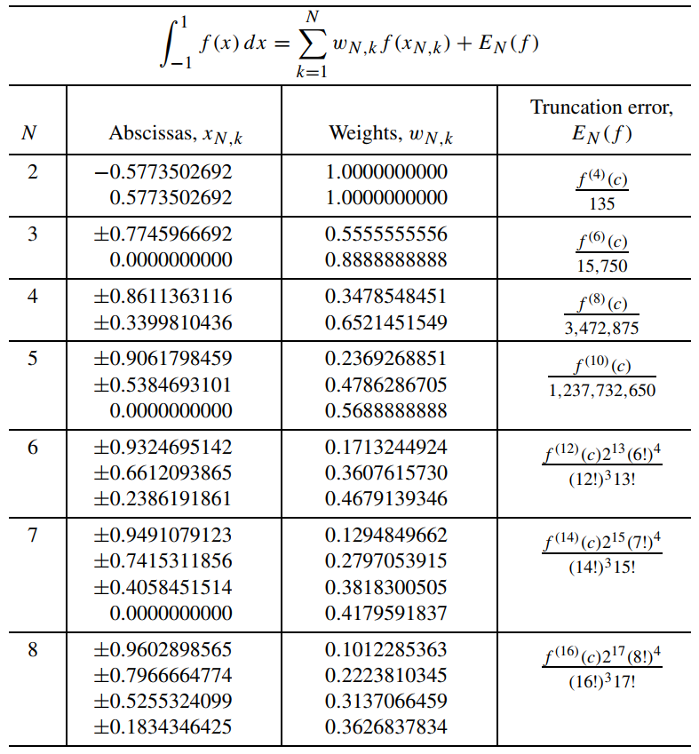

Slide 12
General Python Tips
Define your equations as functions
Test them out, make sure they return the correct values
Initialize your lists
Includes anything you need to track or plot
Determine your iterative
What error or an independent variable are you trying to converge?
Iterate to your solution
Keep track of which variables are inside your loop
What types of values are they?
Are you overwriting any values you need later?
End when stopping criteria is met
Plot your solution
Matplotlib.pyplot.plt
plt.plot(xList, yList (optional)) is the simplest plot
For logarithmic axis:
plt.loglog() plots both axis as log scale, plt.semilogx() plots the x axis as log scale, plt.semilogy() plots the y axis as log scale
Other tips:
Defined functions only track their specified inputs and outputs
If you redefine a variable later in your main script, it will not remember the previous value
If you redefine a single value in a list or array, it will update the array and keep the other array values
If you append a list, it will add the value to the end of the list
Use brackets for indices, parenthesis for calling functions and (if necessary) grouping/order of operations
Parenthesis immediately after a word will likely be treated as a function call
Square brackets immediately after a word will likely be treated as the index of a list or matrix
Someone, somewhere has probably run into the same problem before
Googling your errors or problems is a legitimate way to find programming solutions

